Slide 1
ECUADOR
Lenin Bastidas
9th May, 2017

Slide 2
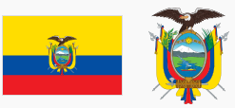
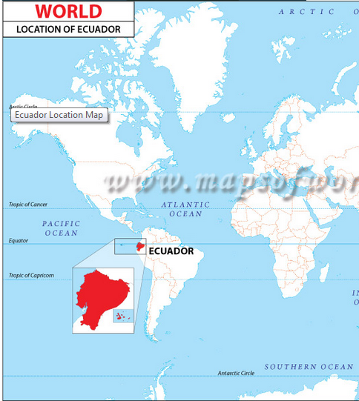
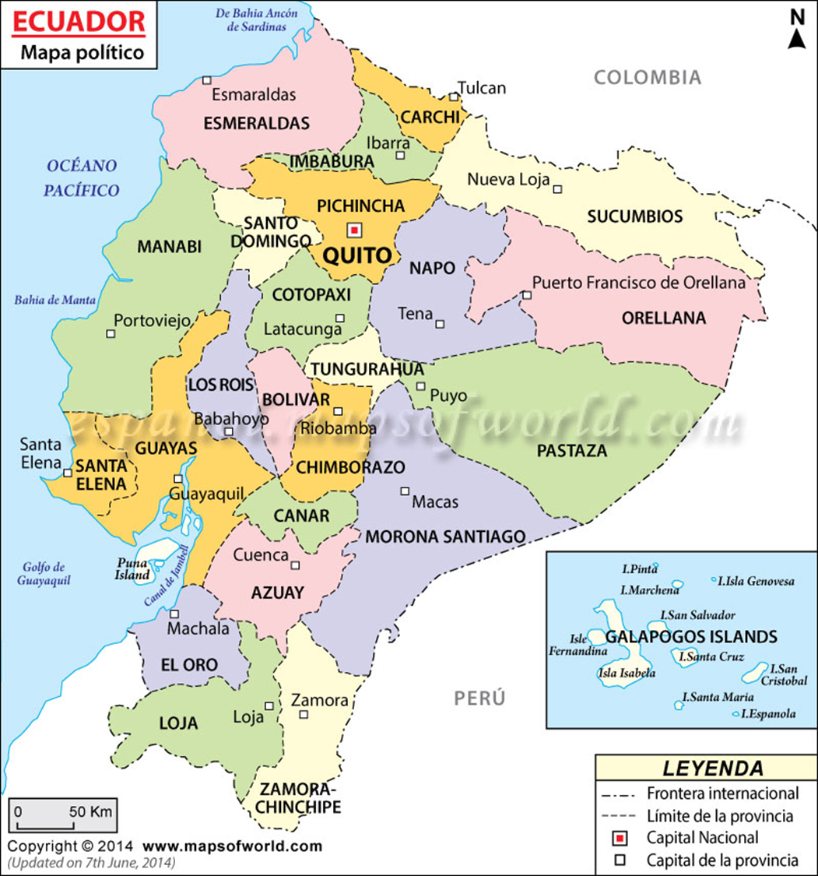
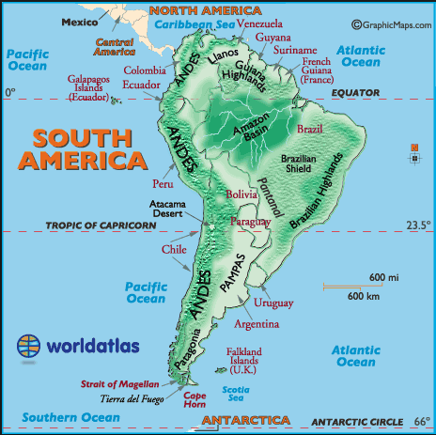
Republic of Ecuador
Andean Region
257 217,07 km²
14 483 499 inhabitants ; 50,44% women and 49,56% men (INEC, Census 2010)
Capital: Quito 2 239 191 inhabitants (INEC, Census 2010) (World Heritage city, 1978) Quito is in the Andes mountain at 2850 m above sea level and It is near of 0° latitude.
10th August, 1810 Independence Day
Official language: Spanish
Recognized languages: Kichwa, Shuara, Wao, and others indigenous languages (Total 14 other languages).
Government: Unitary presidential constitutional republic
Legislature: National Assembly
Currency: United States dollar (USD)
Time zone: Continental Ecuador (-5), Galapagos Islands (-6)

Slide 3
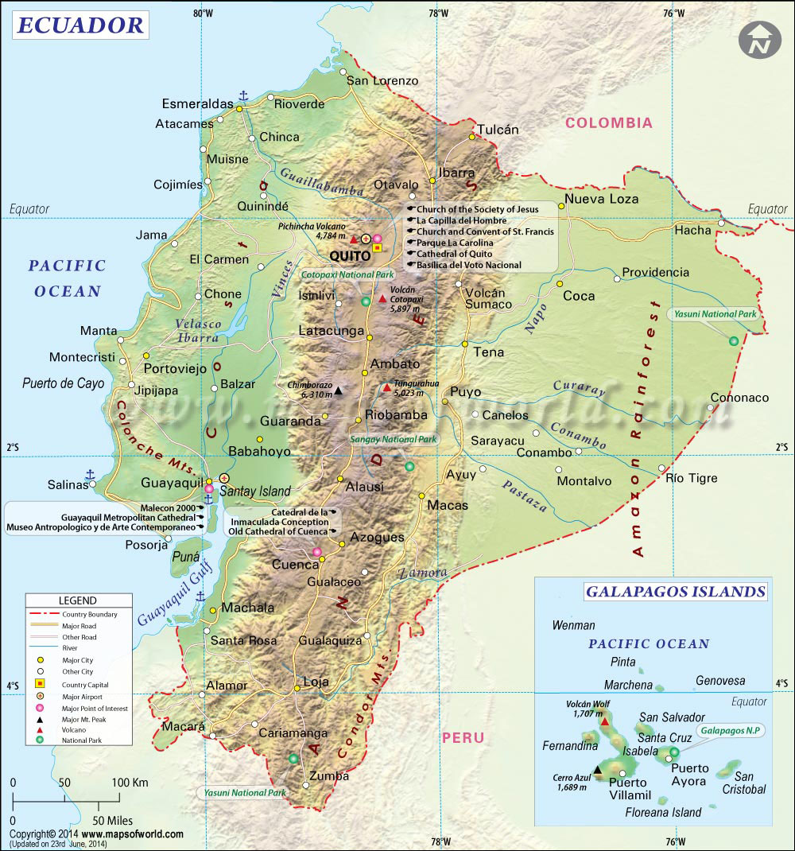
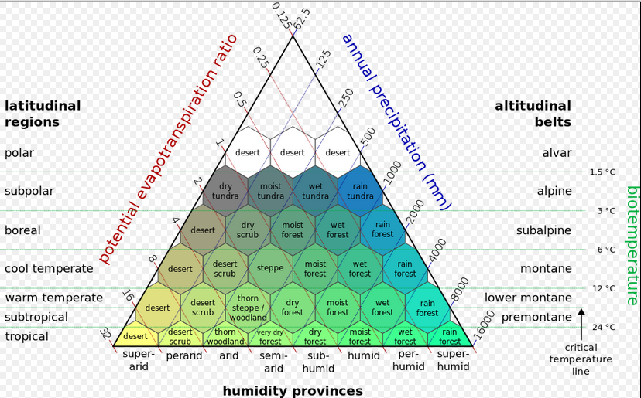
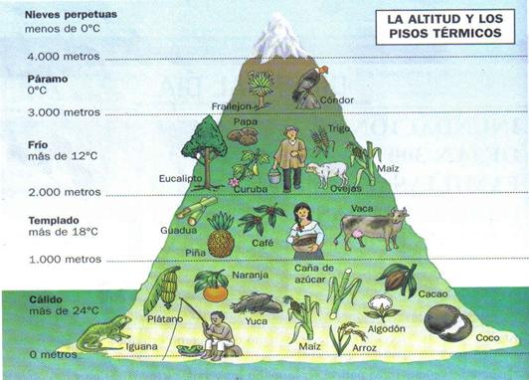
Natural Regions
Holdridge life zones

Slide 4
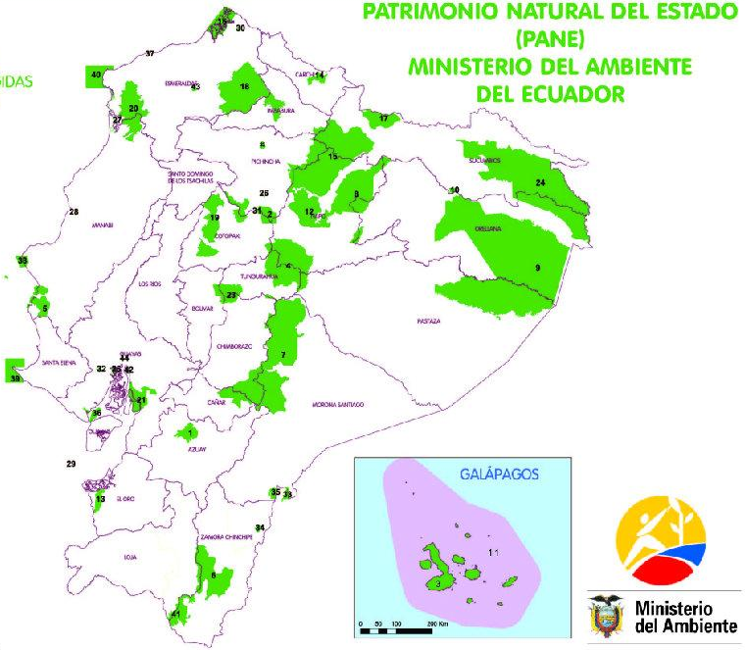
Protection of the Nature
Ecuador has rich ecology. It is one of 17th megadiverse countries in the world with 16000 vascular plant species, 258 mammal species, 1640 bird species, 600 marine fish species, 345 reptile species, 358 amphibian species and 4500 butterfly species.
There are 50 Protected Areas
Ecuador's Galapagos National Park and Sangay National park have been declared UNESCO World Heritage Natural Sites.
The Constitution of 2008 recognized legally enforceable Rights of Nature.

Slide 5
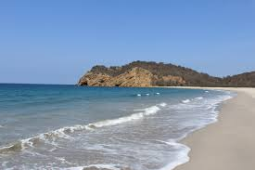
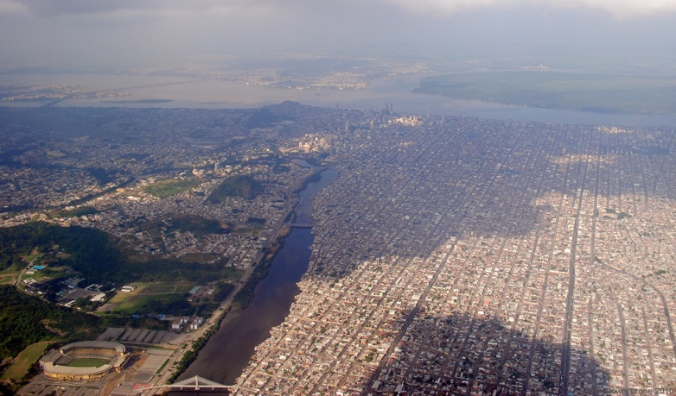
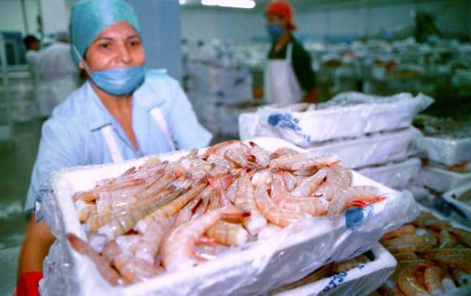
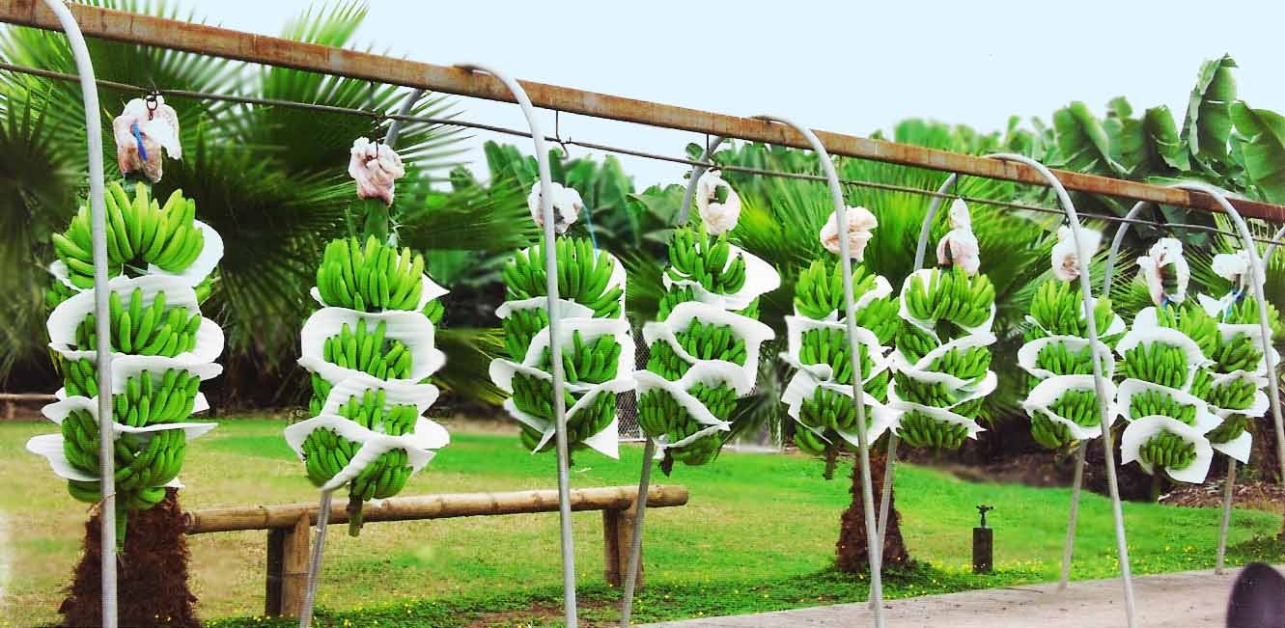
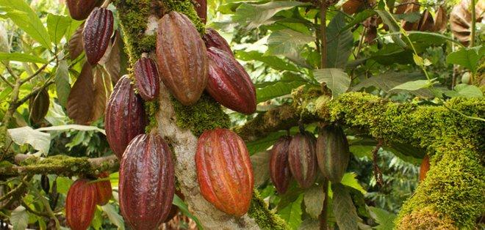
Coastal Region
24 Ecosystems (MAE, 2013). The most representative is the Mangrove forests because transferring organic matter and energy from the land to marine ecosystems (WWF, 2015).
Guayaquil, 2 350 915 inhabitants (the largest city of Ecuador)
The most fertile and productive area of the country (bananas, cacao, rice, sugar cane, oil palm, coffee, fruits, shrimp, fish)
1600 km of beaches
It contains almost the 50% of the population of the country and a few indigenous groups such as: Chachi, Awa, and Tschilas.

Slide 6
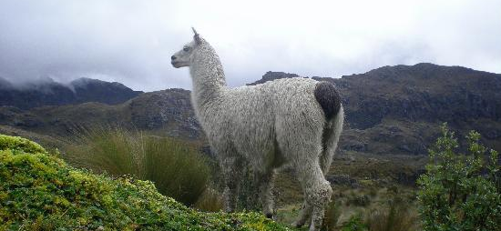
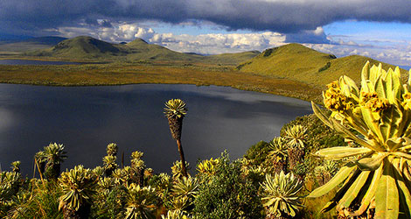
Andes mountain
45 Ecosystems (MAE, 2013) The most represent ecosystem is the Paramo. The main wildlife are: Andean Condor, llamas, Andean bear, deers, pumas, etc.
The Ecuadorian Andes has volcanoes that are more than 5,000 m above sea level. high and are permanently covered with snow and glaciers
The tallest mountain is the Chimborazo 6,310 m. , the actives volcanoes are Cotopaxi 5,897 m. Tungurahua 5,023 m. Sangay 5,300 m. others important elevations are Cayambe 5,790 m. (zero latitude) Iliniza Sur 5,305 m. Antisana 5,704 m.
This region has almost the 45% of the total inhabitants of the country. Also, this region has the Kichwa people that is the major indigenous group of the country.

Slide 7
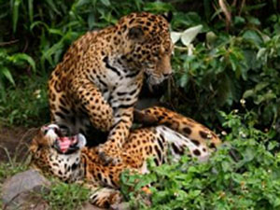
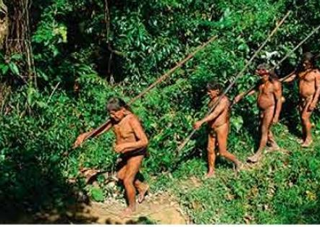
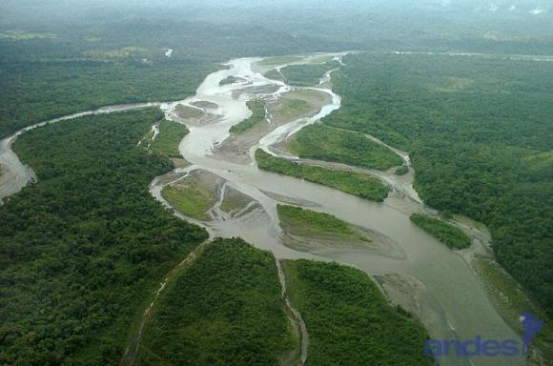
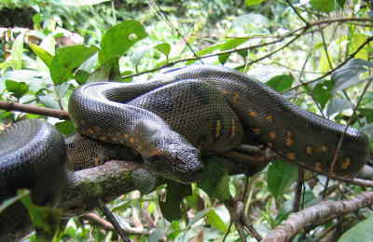
Ecuadorian Amazon
The Ecuadorian Amazon represent the 45,7% of the total territory of Ecuador and It has 22 Ecosystems (MAE, 2013).
The wet tropical forests are the most species-rich biome, and tropical forests in the Americas are consistently more species rich than the wet forests in Africa and Asia.
The Amazon River was discovered from Ecuador in 1542 when the Spanish conqueror Francisco de Orellana was in search of the legendary city of El Dorado.
There are many groups of indigenous such as: Kichwa, Cofanes, Shuaras (Tzansa = Shrunken Head), Waorani, etc.
The north part of the Ecuadorian Amazon has oil that it has been exploited since 1970’s
This region contains around the 5% of the population of the country.

Slide 8
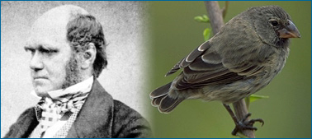
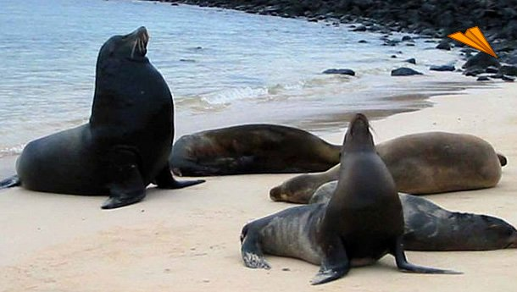
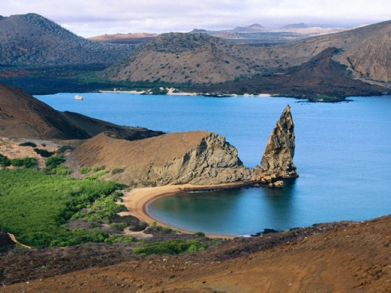
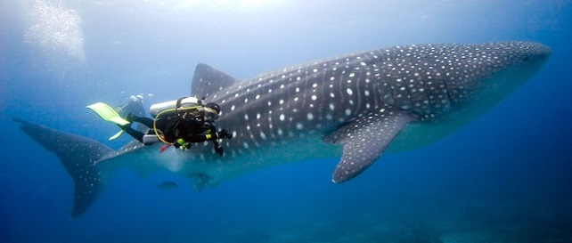
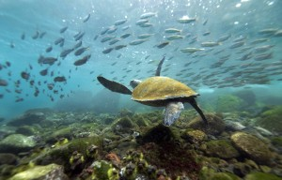
Galapagos Islands
The islands are located at 1000 km from the coast of the Ecuador in the Nazca plate. Then the archipelago is the result of volcanism of a Hot Spot (same Hawai and Canarias).
It has 18 main islands, 3 small islands and 107 rocks.
The extraordinary diversity in land and sea were the result of many factors such as the special location above the latitude zero, crossing of streams marines and the volcanism.
Charles Darwin visited the islands in 1835. There he found that many kind of finches birds and these facts were crucial in Darwin's development of his theory of natural selection explaining evolution, which was presented in The Origin of Species.

Slide 9
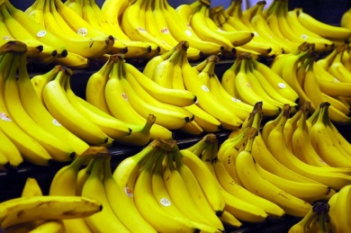
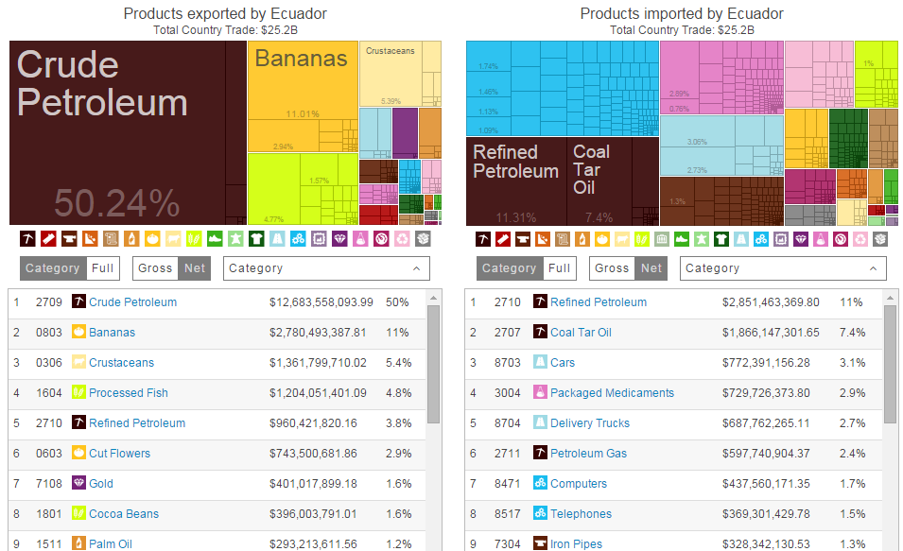
Products exported and imported

Slide 10
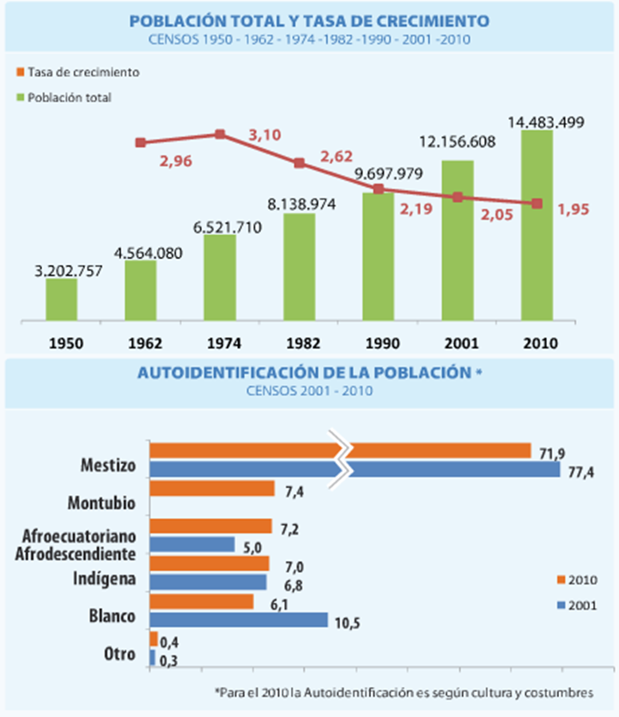
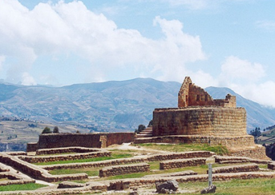
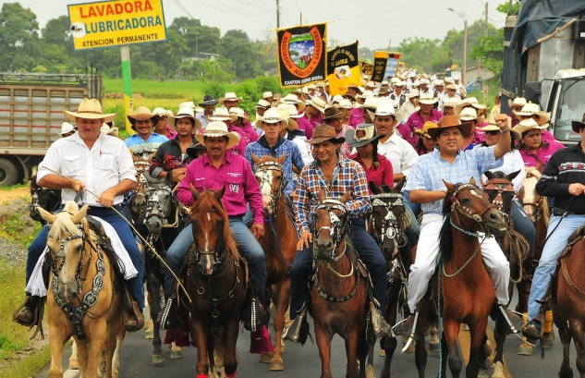
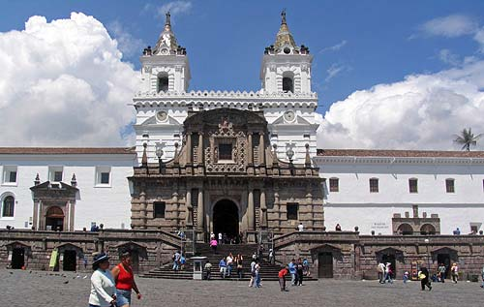
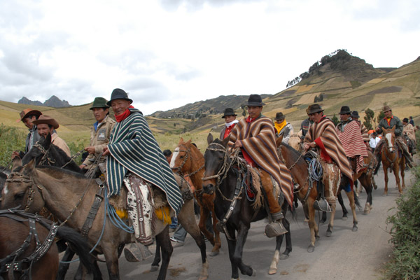
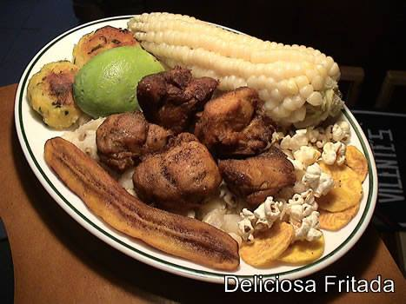
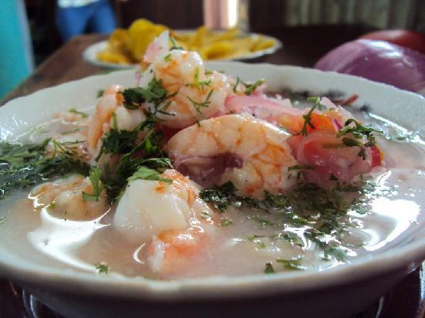
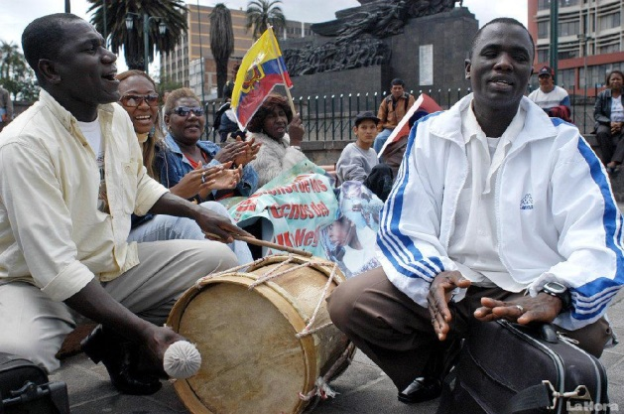
Cultural Diversity

Slide 11
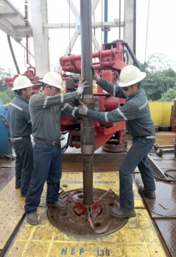
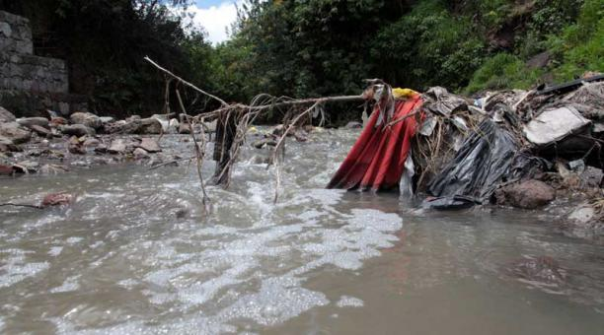
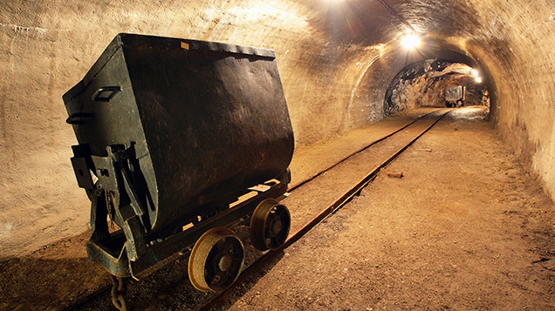
Source of Pollution
The oil spills and informal mines.
The deforestation.
The solid waste.
The wastewater of the cities and industries.

